Slide 1
THE BOLT:
Electric Vehicle Adoption Analysis in Washington State
Geographic, Technical, and Infrastructure Trends from EV Registration Data
Presented by RAM BYRRAJU
05/05/2025
Disclaimer: This presentation is part of a class project for Database Design & Management, MASY1-GC 3500 and is not affiliated with or endorsed by Washington State or Electric Vehicle makers. All content is for academic purposes only.

Slide 2
AGENDA
Project Overview and Objectives
Data Model
Analytical Framework
Key Findings by Goal
Strategic Implications
Recommendations
Closure & Takeaways
00

Slide 3



COMPANY OVERVIEW
Bolt is a Washington-based startup focused on installing EV charging ports.
Target Market:
EV owners in urban and suburban areas
Fleet operators
Businesses seeking EV infrastructure to attract customers
.
Mission:
To accelerate EV adoption by providing convenient, accessible, and strategically placed charging stations across the region.

Slide 4
COMPANY OBJECTIVES
1
2
3
4
Expand EV Charging Infrastructure
Optimize Location Selection
Use data analytics and predictive modeling to identify high-traffic, underserved areas for maximum utilization and accessibility and achieve an Installation Completion Rate ≥ 100% of planned sites
Install 50 new charging stations across Washington state by the end of December 2025 to meet growing EV demand with 98% station uptime
Enhance User Experience
Establish Strategic Partnerships
Achieve 95% CSAT by ensuring reliable uptime, fast charging speeds, and user-friendly payment systems — aligned with continuous improvement under Six Sigma principles
Collaborate with retailers, malls, and municipalities to secure charging station locations and co-marketing opportunities

Slide 5
PROJECT GOALS
Reveal Regional Adoption Trends
Identify hotspots and gaps in EV ownership across counties, districts, and postal codes
Gauge Infrastructure Readiness
Align vehicle concentration with utility coverage to assess current and future charging demand
STRATEGIC OBJECTIVE
Identify high-opportunity locations for EV charging ports in WA and the USA at large
Evaluate Vehicle Ecosystem Performance
Compare adoption and range data by EV type and manufacturer to guide hardware selection
Analyze Adoption Growth Over Time
Track year-over-year changes by city and model year to forecast future expansion areas

Slide 6
DATA DESCRIPTION
216 Target Cities in Washington
8,397 electric vehicle registrations
50 Planned Charging Stations
100+ Potential Host Site Applications
Source: Washington State Department of Licensing EV Registrations
Key Fields: Postal code, county, city, model year, vehicle type (BEV/PHEV), make, e-range, utility provider
Data Volume: Over 100,000 records
Time Coverage: Includes model years from 2010–2024
Structure: Transformed into 3NF and loaded into Oracle SQL Developer

Slide 7
ALGORITHM
Loaded and cleaned raw dataset in Oracle SQL Developer
Populated the relational model with clean data
Visualized the data to support each project goal
STEP 1
STEP 3
STEP 5
STEP 2
STEP 4
Normalized the data to 3NF
Developed analytical SQL views for trend discovery

Slide 8
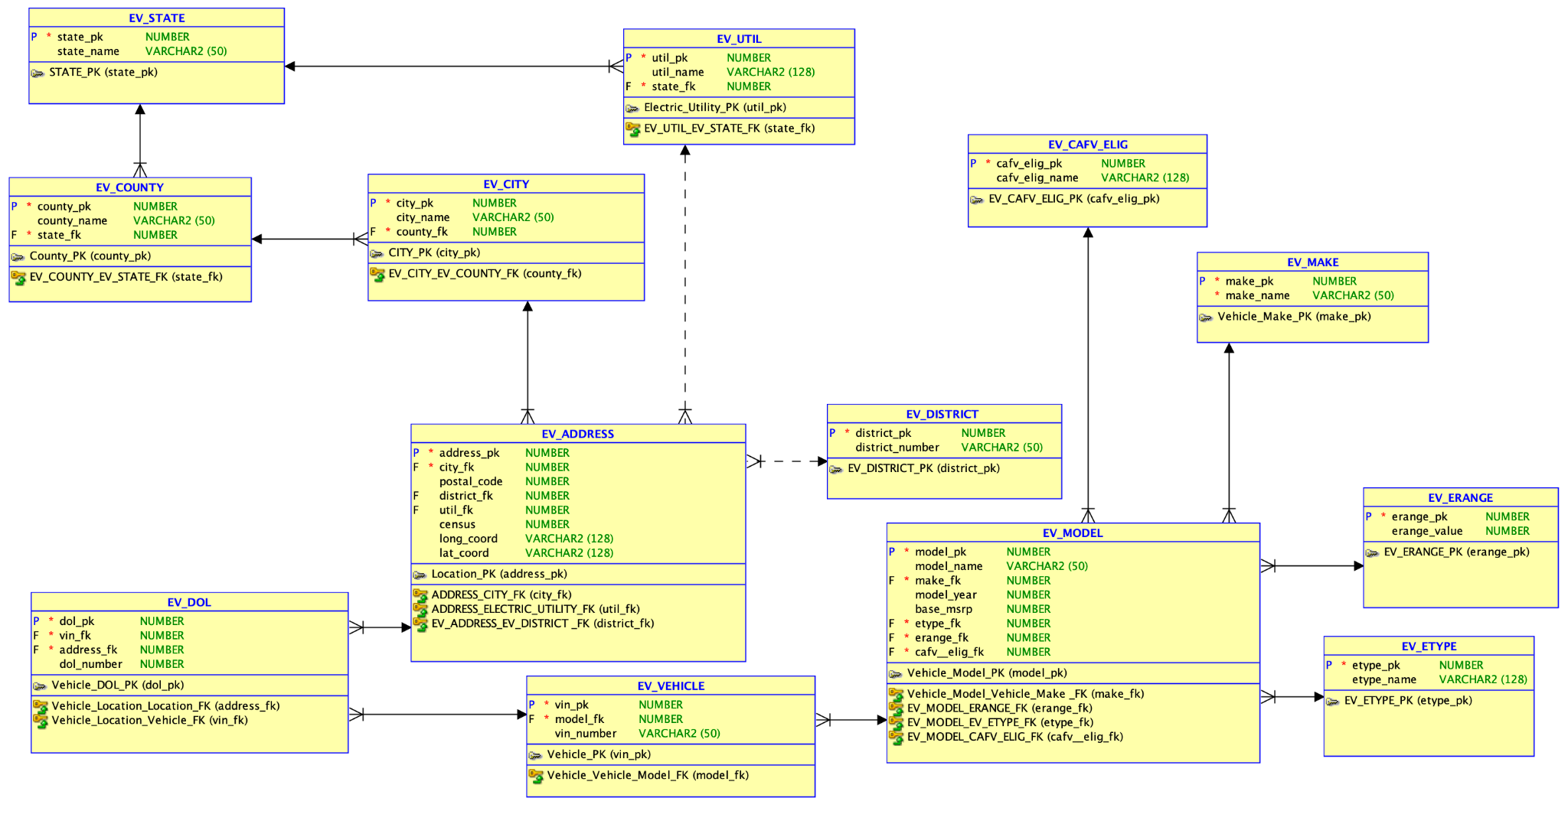
DATA MODEL

Slide 9
Geographic Trends in EV Adoption
01

Slide 10
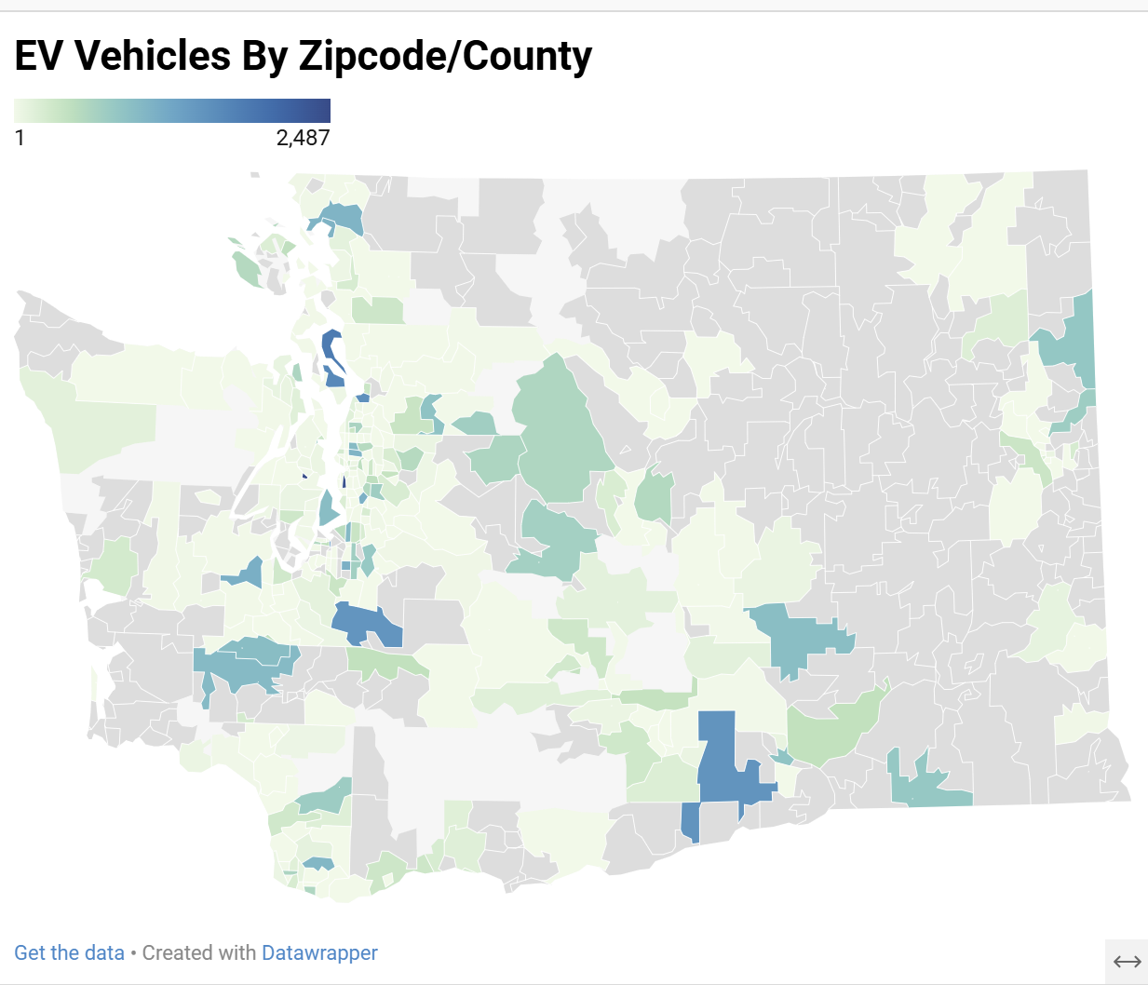
EV Count by County
This chart shows the number of EVs per county in Washington
This helps us identify geographic concentrations of adoption, revealing strong urban-rural disparities

Slide 11
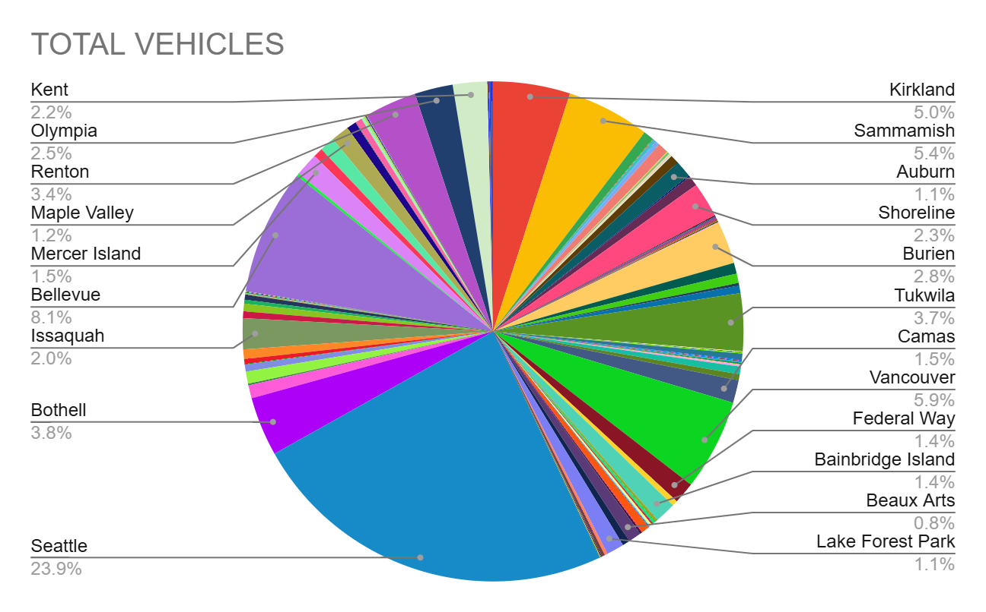
EVs by City
This granular view confirms regional hubs (e.g., Seattle, Bellevue) and underrepresented areas

Slide 12
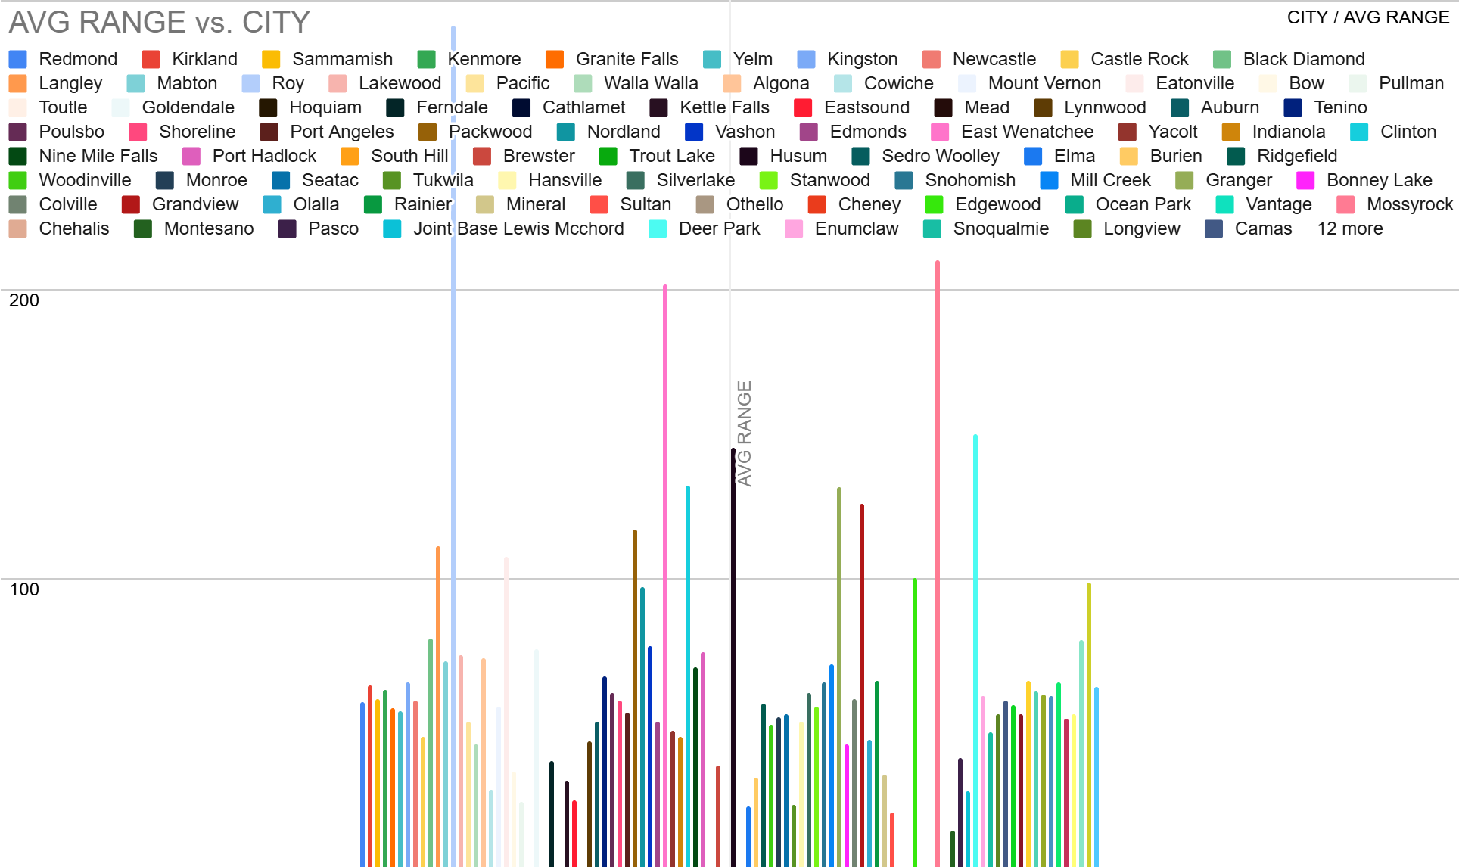
Avg E-Range by City

Slide 13
EV Type and Manufacturer Performance
02

Slide 14
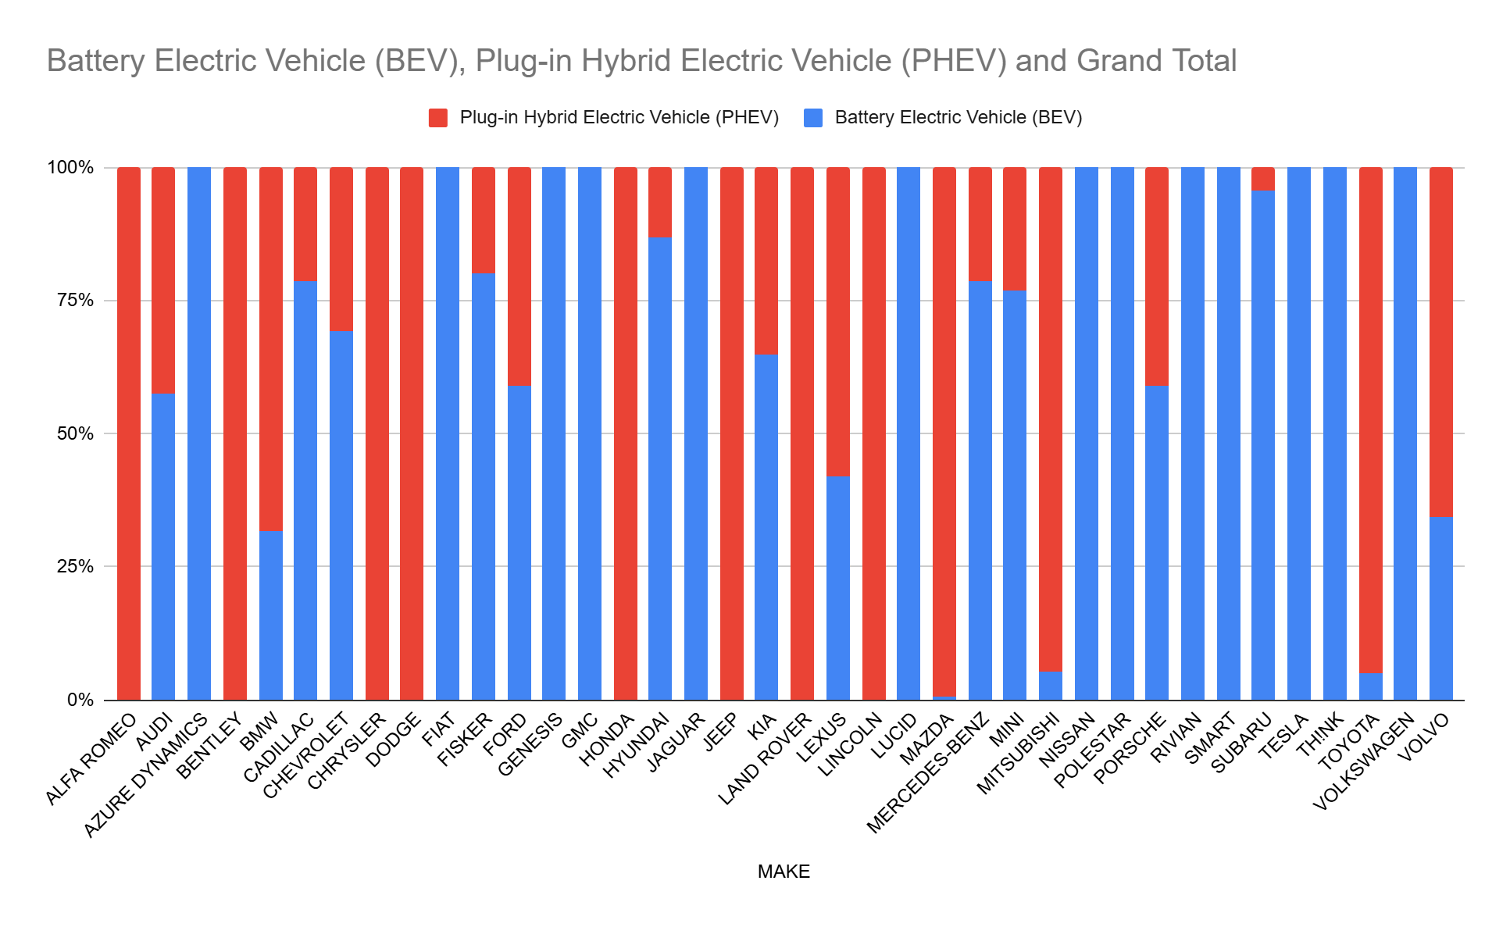
BEV vs PHEV Distribution by County

Slide 15
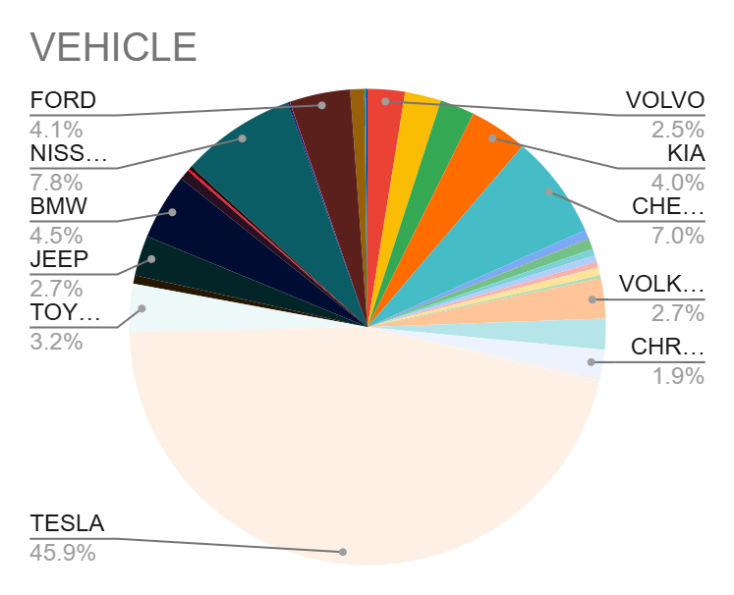
Vehicle Count by Manufacturer
Compares total vehicle count by top EV manufacturers.
Identifies leading brands (e.g., Tesla, Chevrolet) and market penetration.

Slide 16
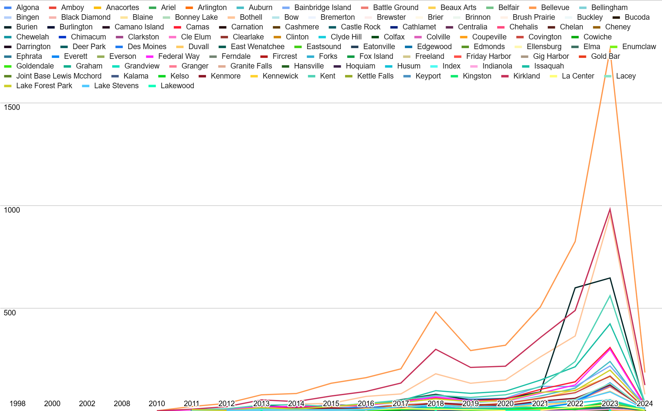
EV count by City and Model Year

Slide 17
Infrastructure and Utility Insights
03

Slide 18
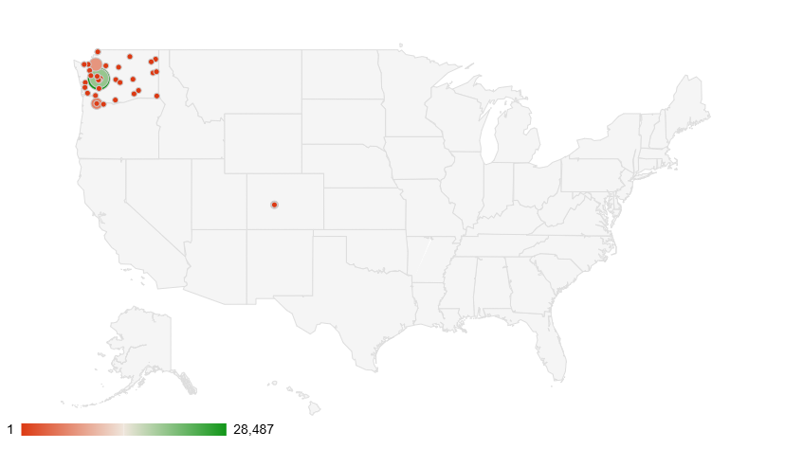
EV Count by Utility Provider

Slide 19
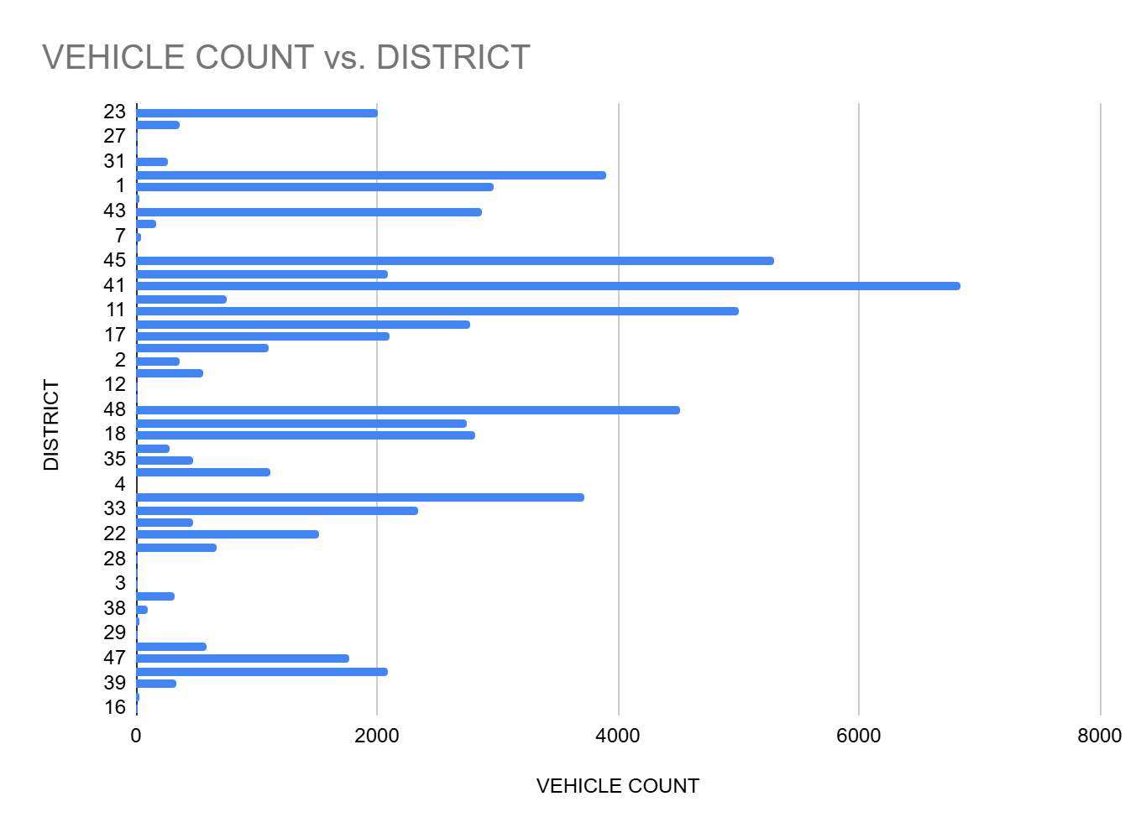
Which legislative districts have the highest EV ownership?

Slide 20
Year-over-Year Growth Trends
04

Slide 21
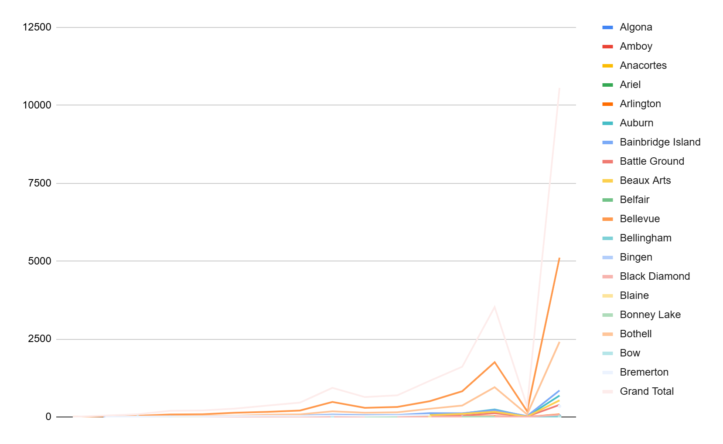
EV Vehicle Count by City by Year

Slide 22
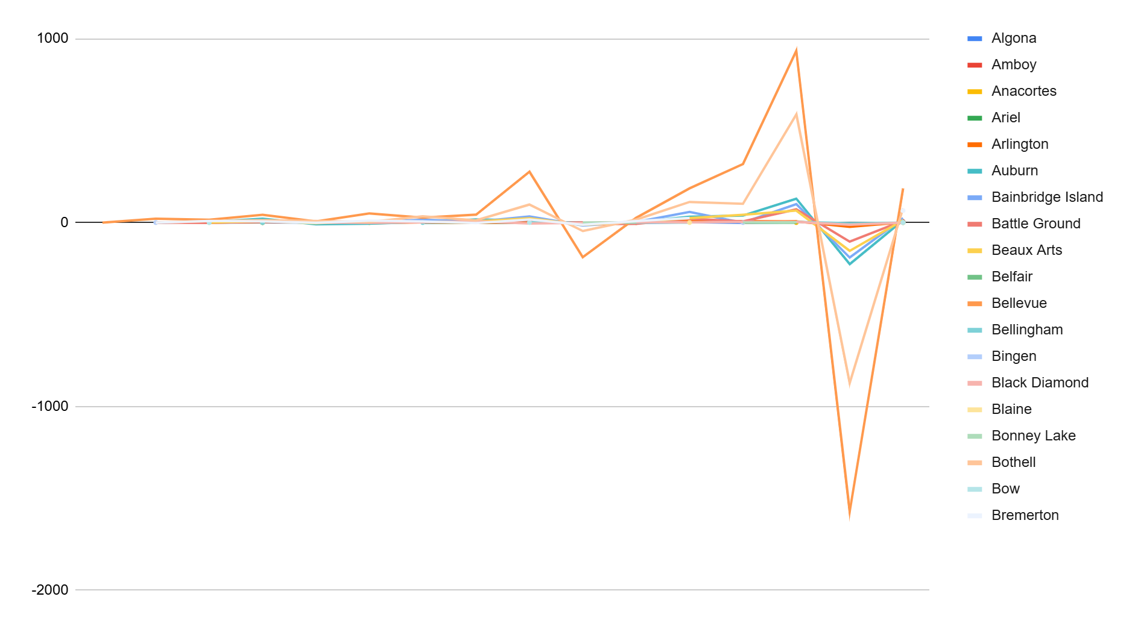
YOY EV Growth By City

Slide 23
EV Charging Station Modeling
05

Slide 24
PREDICTIVE MODELING OF EV CHARGING STATION DEMAND
Modeling Approach
Used Multiple Linear Regression to predict charger demand (Y) based on:
X₁ = EV Count
X₂ = Avg Electric Range
Focused on top 3 EV cities: Seattle, Bellevue, Vancouver.
Applied Ordinary Least Squares (OLS) to minimize prediction errors.
Model generated coefficients (b₁, b₂) showing impact of each predictor.
Final equation estimates chargers needed using a city’s EV count and range.
Variable | Symbol | Description
EV_Count | X₁ | Number of EVs in city
Avg_Range | X₂ | Average electric range in city
Demand | Y | Number of chargers needed

Slide 25
Category | Variable | Value | Interpretation
Correlation Coefficients | r (X₁,Y) | 0.9999752 | Very strong positive correlation between EV count (X₁) and chargers needed (Y)
 | r (X₂,Y) | 0.9974763 | Strong positive correlation between avg range (X₂) and chargers needed (Y)
 | r (X₁,X₂) | 0.9969512 | Strong positive correlation between EV count and avg range
Multiple Correlation | R (X₁,X₂,Y) | 1 | Perfect combined correlation of X₁ and X₂ with Y
Regression Coefficients | b₁ | 0.0036855 | For each additional EV, charger demand increases by +0.0037
 | b₂ | 0.1101556 | For each extra mile of avg range, charger demand increases by +0.1102
 | a | -13.6077 | Intercept: baseline chargers when X₁ and X₂ = 0
City | EV_Count (X₁) | Avg_Range (X₂) | Chargers Needed (Y)
Seattle | 12,500 | 250 | 60
Bellevue | 3,900 | 220 | 25
Vancouver | 3,086 | 220 | 22
 | Avg_Range (X₂) | Chargers Needed (Y)
Average | 230.00 | 35.67
Std Dev | 17.32 | 21.1266

Slide 26
Strategic Policy and Investment Recommendations

Slide 27
ROLLOUT STRATEGY
This phased rollout balances near-term ROI with long-term growth by prioritizing high-adoption areas, filling infrastructure gaps, and aligning with grant timelines—positioning the company as a national leader in EV charging by end of 2025
Prioritize High-Adoption Zones
Target Underserved Utilities
Phase Installations by Region and Demand
Align with Policy and Incentives
Use vehicle count and growth data to identify top counties, postal codes, and legislative districts with high EV concentration and momentum.
Cross-reference utility coverage with vehicle density and e-range data to pinpoint gaps in charging infrastructure despite strong adoption.
Stagger deployment across Q2–Q4 2025 based on regional readiness, with early installs in dense urban/suburban areas and follow-ups in rural growth zones.
Leverage state and federal EV incentives, zoning policies, and utility partnerships to optimize ROI and accelerate approvals in key locations.
01
02
03
04

Slide 28
SUMMARY OF INSIGHTS
01
GEOGRAPHY
TECHNOLOGY
UTILITIES
GROWTH
02
03
04
King, Clark, and Kitsap counties are leaders; rural counties remain under-penetrated
BEVs dominate in range and volume; PHEVs show strong presence in transitional regions
Highest loads concentrated in Puget Sound Energy and Seattle City Light zones
Top cities show accelerating adoption, but 2024 drops hint at saturation or reporting lag

Slide 29
RECOMMENDATIONS
Expand charging in underserved areas (e.g., Yakima, Klickitat) to close coverage gaps.
Coordinate with utility providers to align infrastructure with grid capacity.
Focus rollout in top cities (Seattle, Bellevue, Vancouver) based on highest EV demand.
Tailor incentives based on local preference for BEV vs. PHEV vehicles.
Plan for additional chargers in rural areas as lower-range EV models increase.
Use predictive modeling to guide future expansion and resource allocation.

Slide 30
CLOSURE &
TAKE-
AWAYS
EV adoption is geographically uneven, technologically diverse, and infrastructure-dependent
Our data-driven approach reveals actionable patterns to guide investment and planning
Next steps: integrate policy, forecast growth, and map charging station priorities

Slide 31
THANK YOU!
QUESTIONS?
Disclaimer: This presentation is part of a class project for Database Design & Management, MASY1-GC 3500 and is not affiliated with or endorsed by Amazon. All content is for academic purposes only.

Slide 32
REFERENCES
Oliveira, W., & Ahmed, Z. (n.d.). Electric vehicle population dataset. Kaggle. Retrieved from https://www.kaggle.com/datasets/willianoliveiragibin/electric-vehicle-population
U.S. Department of Energy. (n.d.). Alternative Fuels Data Center (AFDC). Retrieved May 5, 2025, from https://afdc.energy.gov
International Energy Agency. (2024). Global EV outlook 2024. https://www.iea.org/reports/global-ev-outlook-2024
Washington State Department of Transportation. (2023). Washington state electric vehicle infrastructure plan. https://wsdot.wa.gov/construction-planning/ev-infrastructure

Slide 33
Appendix
Regression equation Y′ = a + b₁·X₁ + b₂·X₂ Correlation
r(X₁,Y)
r(X₂,Y)
r(X₁,X₂)
r(X₁,Y): correlation EV_Count & Chargers
r(X₂,Y): correlation Avg_Range & Chargers
r(X₁,X₂): correlation EV_Count & Avg_Range
Compute R (multiple correlation)
R(X₁,X₂,Y) = sqrt( r(X₁,Y)² + r(X₂,Y)² - 2*r(X₁,Y)*r(X₁,X₂)*r(X₂,Y) / (1 - r(X₁,X₂)²))
Compute slopes (b₁, b₂)
b₁ = (r(X₁,Y) - r(X₁,X₂)*r(X₂,Y)) * SD(Y) / ((1 - r(X₁,X₂)²)*SD(X₁))
b₂ = (r(X₂,Y) - r(X₁,X₂)*r(X₁,Y)) * SD(Y) / ((1 - r(X₁,X₂)²)*SD(X₂))

